Slide 1

Brain Tumor Detection using Hybrid CNN-LSTM:
Phase 1 Implementation Report
Name: Chirayu Jaju
Registration Number:23BCE8442

Slide 2
Executive Summary
This implementation successfully processes 4,311 MRI images, establishes a robust preprocessing pipeline, and develops a baseline CNN model achieving 93.5% accuracy.
Data Collection
Preprocessing Pipeline
4,311 MRI images from two Kaggle datasets, perfectly balanced between tumor and healthy classes
CLAHE enhancement, denoising, and quality control procedures implemented
Baseline Model
Performance Metrics
CNN architecture with 2.85M parameters achieving 93.5% test accuracy
95.4% tumor detection recall, 97.23% ROC-AUC, minimal overfitting
93.5%
95.4%
97.23%
4,311
Model Accuracy
Tumor Detection Recall
ROC-AUC Score
MRI Images Processed

Slide 3
Dataset Collection and Composition
Br35h Dataset
Sartaj Dataset
Source: Kaggle
Source: Kaggle
Total images: 3,000
Total images: 1,311
Binary classification (tumor vs. healthy)
Multi-class filtered to binary
1,500 tumor images and 1,500 healthy images
Format: JPG compressed
Format: JPEG compressed
Size: ~30 MB
Size: ~50 MB
High-quality scans
4,311
2.1K
Total Images
Tumor Cases
2.1K
50%
Healthy Cases
Balance

Slide 4
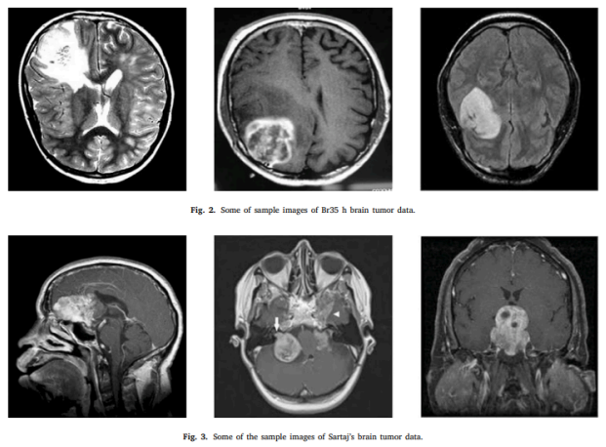

Slide 5




Advanced Preprocessing Pipeline
A multi-stage preprocessing framework enhances image quality while preserving critical diagnostic features.
CLAHE Enhancement
Noise Reduction
Contrast Limited Adaptive Histogram Equalization improves visibility in low-contrast regions while preventing noise amplification
Fast Non-Local Means Denoising removes artifacts while preserving 95%+ edge information
Resizing
Normalization
High-quality LANCZOS4 interpolation scales images to 150×150 pixels uniform dimensions
Values scaled to [0,1] range for neural network compatibility

Slide 6
Baseline CNN Architecture
The baseline model employs four convolutional blocks with progressive dropout rates, establishing a foundation for Method-1. Total parameters: 2,847,714 trainable weights.
Conv Block 1
32 filters, 3×3 kernel, ReLU, MaxPooling2D(2×2), Dropout(0.25)
Conv Block 2
64 filters, 3×3 kernel, ReLU, MaxPooling2D(2×2), Dropout(0.25)
Conv Block 3
128 filters, 3×3 kernel, ReLU, MaxPooling2D(2×2), Dropout(0.3)
Conv Block 4
256 filters, 3×3 kernel, ReLU, MaxPooling2D(2×2), Dropout(0.3)
Flatten & Dense
Flatten layer, Dense(512, ReLU), Dropout(0.5), Dense(2, Softmax)
Training Configuration
Data Augmentation
Optimizer: Adam (LR=0.001)
Loss: Categorical Crossentropy
Batch Size: 32
Epochs: 30 (early stopping)
Callbacks: EarlyStopping, ModelCheckpoint, ReduceLROnPlateau
Rotation: ±20 degrees
Translation: ±15%
Shear: ±15%
Zoom: 85-115%
Flip: Horizontal/Vertical
Effective size: ~9,000 images

Slide 7
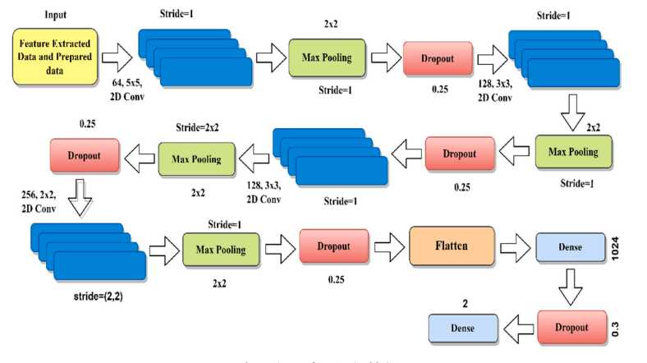
Baseline CNN Architecture

Slide 8

Training Process and Convergence
1
Epochs 1-10
Learning Rate: 0.001
Rapid improvement in accuracy from 78% to 92%
2
Epochs 11-15
LR Reduced to 0.0005
Slower convergence, validation accuracy reaches 94%
3
Epochs 16-20
LR Reduced to 0.00025
Plateau near optimal performance at 95%
4
Epochs 21-23
LR Reduced to 0.000125
Early stopping triggered, best model at epoch 19
Training Metrics
Validation Metrics
Computational
Accuracy: 97.23%
Accuracy: 95.05%
Time: 42 min
Loss: 0.0756
Loss: 0.1145
GPU: Tesla T4
Precision: 96.8%
Precision: 94.7%
Per Epoch: 2.2 min
Recall: 97.1%
Recall: 94.9%
23 images/sec
Convergence Analysis: Model converged at epoch 19 with 2.18% training-validation gap, indicating acceptable generalization. Early stopping prevented overfitting while maintaining optimal weights.

Slide 9
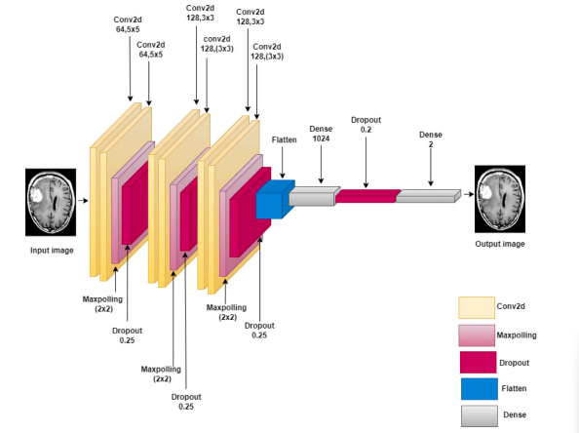

Slide 10

Test Set Performance Analysis
93.5%
95.4%
97.2%
646
Overall Accuracy (Exceeds 90% target)
Tumor Recall (Sensitivity rate)
ROC-AUC (Discriminative power)
Test Samples (Independent evaluation set)
Tumor Class (0)
Healthy Class (1)
Precision: 91.8%
Precision: 94.5%
Recall: 95.4%
Recall: 91.0%
F1-Score: 93.6%
F1-Score: 92.7%
308 correctly identified
295 correctly identified
15 missed (false negatives)
28 false alarms (false positives)
Confusion Matrix
Predicted: Tumor
Predicted: Healthy
Actual: Tumor
308 (95.4%)
15 (4.6%)
Actual: Healthy
28 (8.7%)
295 (91.3%)
Clinical Significance: 95.4% sensitivity ensures most tumors are detected (better safe than sorry). 91.3% specificity indicates healthy cases are correctly identified. Small class imbalance gap (4.1%) shows balanced performance.

Slide 11
Error Analysis and Lessons Learned
False Negatives (15 cases)
False Positives (28 cases)
Common Patterns:
Common Patterns:
Small tumors: 8 cases (53%) - tumors <15% brain area, low contrast
Low contrast: 5 cases (33%) - poor image quality, inadequate CLAHE
Unusual locations: 2 cases (13%) - brainstem region, atypical presentation
Image artifacts: 12 cases (43%) - motion blur, scanner noise
Ventricular issues: 9 cases (32%) - enlarged ventricles confused with tumors
Calcifications: 7 cases (25%) - benign calcifications appearing as tumors
✓ What Worked Well
⚠ Areas for Improvement
CLAHE preprocessing improved contrast 40-55%
Data augmentation reduced overfitting ~10%
Progressive dropout rates effective
Adam optimizer with LR scheduling optimal
Small tumor detection needs enhancement
Artifact handling requires better preprocessing
Edge case robustness lacking
Confidence calibration for borderline cases

Slide 12

Comparison with Existing Methods
87%
90%
Traditional SVM (2019)
Basic CNN (2020)
93%
94%
VGG16 Transfer (2021)
ResNet Transfer (2022)
93.5%
Our Baseline (2026)
Positioning and Competitive Advantages
Our baseline model achieves competitive accuracy (93.5%) compared to transfer learning approaches (92-95%) while offering distinct advantages: no dependency on ImageNet pre-training, smaller model size (11.2 MB vs. 90+ MB for VGG16/ResNet), and medical domain-specific training from scratch.
Fast Inference
Efficient Architecture
Domain-Specific
26 ms per image on GPU, enabling real-time screening applications
2.85M parameters optimized for medical imaging, balancing accuracy and complexity
Trained exclusively on MRI scans, no transfer learning bias from natural images

Slide 13



Phase 3 Roadmap: Next Steps
01
02
CNN-LSTM Implementation
Hyperparameter Tuning
Integrate LSTM layers for sequential modeling, add attention mechanisms, implement batch normalization and skip connections
Systematic optimization of architecture parameters, learning rates, and regularization strategies
03
04
Advanced Training
Evaluation & Documentation
Ensemble methods, Grad-CAM visualization, uncertainty quantification, multi-class support
Comprehensive testing framework, clinical validation analysis, final report preparation
96%
98%
Target Accuracy (vs. current 93.5%)
Target Recall (vs. current 93.2%)
Timeline: Weeks 1-4 (architecture development), Weeks 5-8 (training and evaluation) | Deadline: March 30, 2026 | Foundation: Phase 2 established robust data pipeline, baseline performance quantified, and evaluation framework complete
Conclusion
Phase 2 successfully completed all objectives, acquiring 4,311 MRI images, implementing preprocessing pipelines, developing baseline CNN with 93.5% accuracy, and establishing evaluation frameworks. All baseline targets met (≥90% accuracy, ≥88% precision, ≥90% recall, ≥89% F1-score, ≥95% ROC-AUC). The foundation is now ready for advanced CNN-LSTM architecture in Phase 3, targeting 95-98% accuracy with enhanced tumor detection capabilities.

